Slide 1

Bank marketing (campaign)
Data science project
Group name: Fleifel-solo
Name: Rania Tarek Fleifel
Email: raniatarekfleifel@gmail.com
Country: Egypt, College: Cairo university Faculty of engineering
Specialization: Data science
Internship Batch: LISUM13: 30
Submission date: 21st December 2022
Github repo: Bank marketing Campaign

Slide 2
Bank marketing (campaign)
Problem description
Provide ABC bank with a predictive model that enables them to target costumers who’re more probable to invest in their new term deposit product.
Subcategories of the study
Data preparation
Uni-variate data analysis
Features’ imputation
Problems with the dataset
Feature engineering
Transformation and scaling
Prediction

Slide 3
Data preparation
Data intake
Pinpoint missing values
Data Cleaning
Whitespaces
16 available features and 1 binary target
Pinpoint ambiguous values
bank_full.csv
7 Numeric
Synchronous dtypes per feature
8 Categoric
Special characters
De-capitalize
Data Assumptions:
Data provided is correct, there’s no wrong reporting of data .
The data spans all year including weekends and holidays.
Means of communication, other than phone and mobile, are not considered.

Slide 4
Uni-variate Data Analysis
Type of feature
numeric/ categoric
ordinal/ nominal
contextual division
Personal standing features
Financial standing features
Current campaign contact features
Previous contact features
Features’ characteristics
Numeric
dtype, NaNs, zeros
range, mean, median, std
skew, kurtosis
Categoric
list of values
dtype, NaNs, zeros
distribution of values
nominal/ordinal
nominal/ordinal

Slide 5
Features’ imputation
New features:
Given that the data is ordered, we can deduce the year of each instance.
Impute day_of_week from day,month,year
For social and economic indicators from Portugal in from May 2008 to Dec 2010 , data is retrieved from data.nasdaq and bpstat.bportugal to represent employment, consumer price index, consumer confidence index and euribor.

Slide 6
Features’ imputation
Missing values:
euribor3m has zeros that are caused by 3 decimal approximation that would be misleading to predictive models. Hence we use forward-filling to fill each zero-valued euribor3m with the most recent non-zero value
Ambiguous values:
poutcome=‘unknown’ with (pdays=99 or previous=0) is changed to a less ambiguous value indicating no previous contact ‘non-existant’
For Features with “unknown” fields, regardless how they’re encoded, induce a binary indicator to indicate whether this data was present or not.

Slide 7
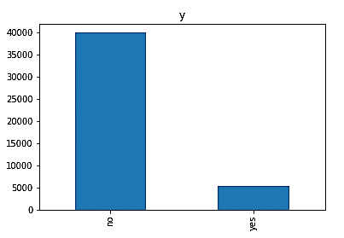
Problems with the dataset
Problems with the dataset
Skewness → throws the predictive models’ results because errors are not distributed evenly around the mean
Outliers → leads to misleading interpretation of data and overlooking important details in favor of capturing extreme values
Class imbalance → more training on the majority class means unfair predictions against the minority class, So criterion such as accuracy becomes quite misleading.
Factors to consider while encoding features:
High cardinality → results in non-conclusive models that fail to generalize well
High dimensionality → causes slow predictions and high complexity
Ordinal/nominal nature → whether it makes sense to numerically order features.

Slide 8
Feature engineering
Encode categoric features
Multi-variate analysis
Bin continuous numeric features
Label encoding
age → age_grp
Pearson correlation
Deduce new features
rec
overdraft
balance (continuous) → balance (binned)
indebt
Hot encoding
Target encoding
Drop un-needed features
day
pday
rec is a binary indicator, that’s equal 1 for the recession period in 2008 and until June 2009
overdraft is a binary indicator, that’s equal 1 for balance<0
indebt is a representative of number of loans per costumer (loan+housing+default)

Slide 9
Transformation and scaling
Numeric encoded (originally categoric) features → Do not scale or transform this data. Attempting either on these features will make the features lose their categoricity.
Numeric (economic indicators) features → Transform but do not attempt to remove outliers. Extreme values in this case are all meaningful and crucial to the conclusion
Numeric (continuous) features → Transform and scale as needed
To combat skewness → Transform feature df[n]
Shift features to have all values at least 1
df[n]=df[n]-(df[n].min()-1)
Log transform
Log(df[n])

Slide 10
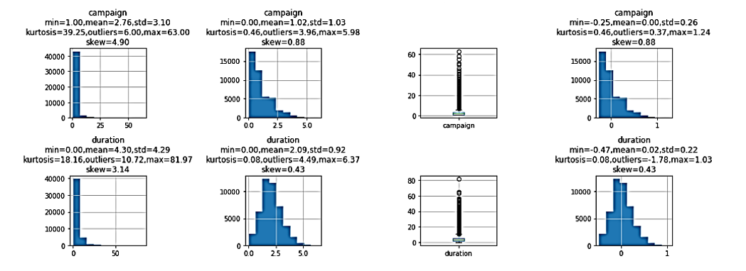
Transformation and scaling
To combat outliers → Scale feature df[n] using robust scaler
To decide on features to be scaled using this method
If (df[n].max()>Q3 + 1.5 * IQR) or (df[n].min()<Q1 - 1.5 * IQR) → scale
This scaler utilizes the centering and scaling on data within the defined percentile (0.1,0.99). This isolates the effect of outliers on the scaled data and maintains the same distribution.

Slide 11
Prediction
Train-test split:
Stratified 80% to 20% division between training and testing sets.
Guarantees same “imbalanced” distribution between the two sets.
Choice of metric:
NOT accuracy → because of imbalanced classes that would give misleadingly high accuracy even when minority class isn’t being correctly classified at all
NOT ROC-curve→ very sensitive to skewed data
NOT recall → we don’t really care that the model predicts lots of “1s” if they’re not correct
Therefore, Precision → the objective is to call costumers who are likely to use deposit products
(aka True positives)

Slide 12
Prediction
Predictive model used → XGBoost classifier
Reason of choice:
Tree-based model: robust to skewness and outliers
Gradient descent is used to fix errors in trees that joined the model in newer trees
Trees are added until no further improvements can be made.
Doesn’t require scaled-features
Has hyperparameter scale_pos_weight that controls the weight given to wrong classifications in different classes (combats class imbalance)
Hyperparameter tuning:
The scale_pos_weight is set relative to the ratio between the positive to negative class in the training set (estimate), encouraging the model to over-correct the positive class

Slide 13
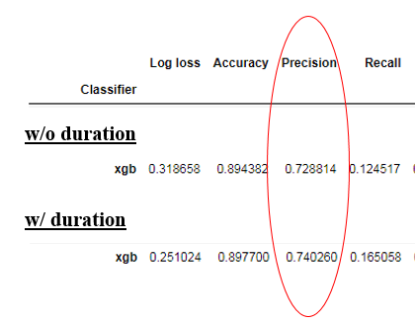
Prediction
Results
The choice of weight improves the detection of the minority class, but it also confuses the majority class quite a lot. We believe this trade-off is still sensible in our problem. This result means that if the marketing team focus on the positively-predicted costumers, 72% of them will go-for the deposit product.
The feature duration is problematic from a logical perspective since the duration of the call is registered after the attempt to convince the costumer is already concluded. So the outcome of the conversation is already known.

Slide 14
Thank You

